Slide 1
Sustainability: Challenges at an Inflection Point
Michael Ruffner| July 26, 2018

Slide 2
Starting at the End

Slide 3
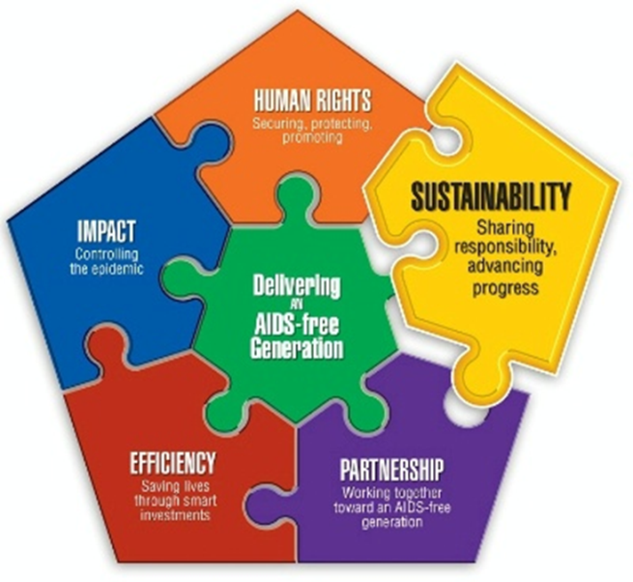

PEPFAR Sustainability Position Paper
https://www.pepfar.gov/about/agendas/sustainability/index.htm
Describes Elements of Sustainability
Lays out Short, Intermediate and Long term Plan of Action

Slide 4
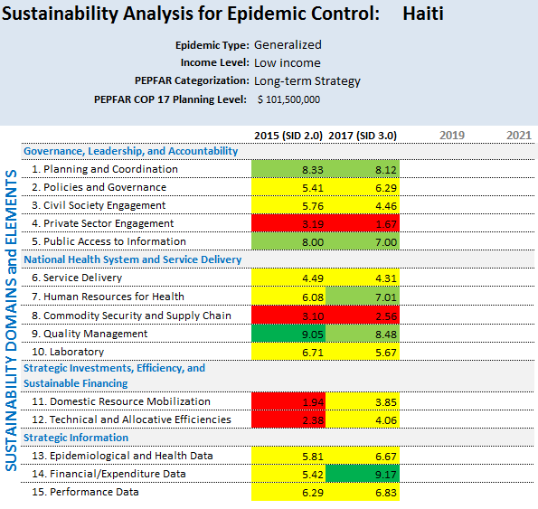
The Sustainability Index and Dashboard (SID)
https://www.pepfar.gov/countries/cop/sids/index.htm
The SID: Describes the Steady State, Focuses on Form and Functionality,
Charts Progress, Takes a Systems approach
The SID is NOT decisional, does NOT dictate investment

Slide 5
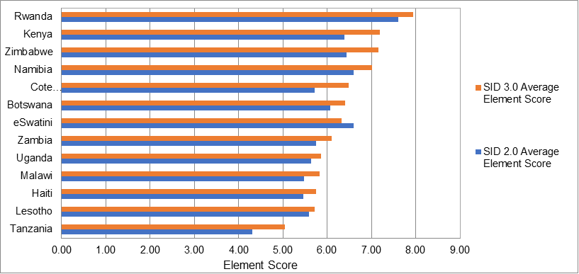
Focused Effort on SID Results in Progress
Sustainability is Hard-Wired into Policy, Process, Strategy and Budget

Slide 6
Challenges and Initial Thoughts

Slide 7
Epidemic Control is a Precondition of Sustainability

Slide 8
How to Bring the Future into Annual Budget
Sustainability and Systems-Building take multiple years
The SID only describes the end point, not the steps on the path
“Table 6” is the mechanism to make systems investments equal to annual targets
  Describe outcome
  Create timeline to completion
  Validate Baseline
  Set annual benchmarks
  Correlate to SID and monitor functionality
Systems strengthening is a time limited investment
  What is good enough?

Slide 9
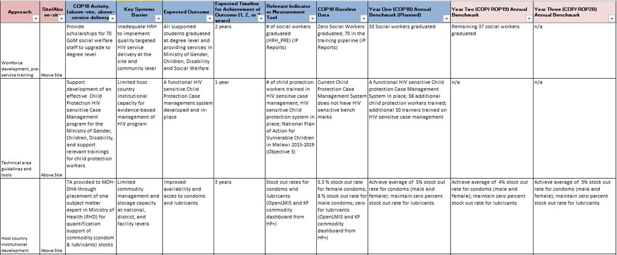
Table 6 Example

Slide 10
We know what we pay, but what does it cost?
A lower cost, more efficient system is a sustainable system
  PEPFAR is focused on efficiency to continue gains against flat budget, but also to lower overall costs.
Problem: What are our actual activities? What do those activities actually cost? What activities are correlated with outcomes?
Innovations:
  Evolution of Expenditure Analysis
  Assuring Fidelity of Work Plan to Strategy
  Activity-Based Costing systems

Slide 11
What Does PEPFAR Really Do?
What is Said
Care and Treatment
What is Heard
Direct Services
What Really Happens
“Package of Activities”
  2/3rd Above Service Delivery

Slide 12
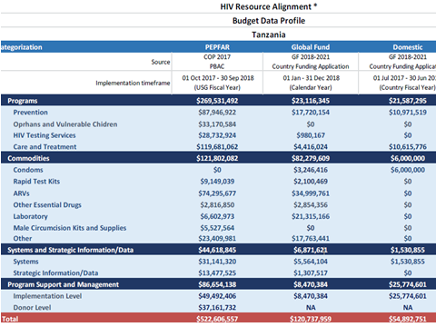
Aligning Budgets and Expenditures

Slide 13
The Reality of Current Functional Responsibilities
Functionally, countries are already leading critical areas:
  Governance and policy
  Strategic management of the response
  Countries provide infrastructure and most of the manpower
  Financial contribution is underestimated and grossly underestimates importance of Domestic investment
Donor assistance supports government through:
  Commodities
  Technical assistance
  Financing surveillance
  Financing health systems strengthening
  Supporting capacity building and salary support
Notes:
Responsibility Matrix – currently on the drawing board

Slide 14
Funding Local Organizations for Sustainable Epidemic Control
PEPFAR has been investing in indigenous organizations as a pathway to sustainable epidemic control; this approach will be accelerated, aiming for 70% of funding to indigenous partners as primes across the program by the end of FY 2020.
    Indigenous partners can be governmental or non-governmental, including community-based organizations, universities, among others
Key components of PEPFAR’s approach to sustainability include:
    Engaging community-led civil society organizations as partners in the delivery of health services to reach underserved and marginalized communities
    Promotion of systems that support funding and engagement of civil society organizations (CSOs) and that reduce donor dependence

Slide 15
A Look to the Future

Slide 16



PEPFAR Spending will Change Over Time
Commodities will increase
VMMC will decrease over time
HTS will decrease over time
HSS will decrease over time
Training, TA and Mentoring will decrease over time
What’s left?
What happens if we reduce it?
We don’t really understand how result is achieved, cost
End State is Clear,
Reality is Messy
Programming changes,
Transfer Responsibility
Notes:
PEPFAR is not Transitioning out of countries – programming mix, spending levels, cross country ratios will change

Slide 17
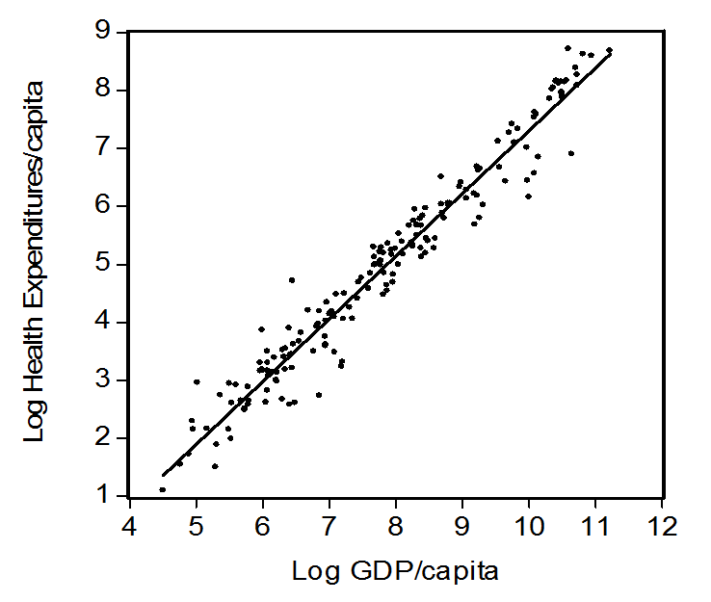
“The First Law of Health Economics”

Slide 18
Long Term Financing
Large scale health insurance/coverage takes a long time to set up and mature
There is untapped ability and willingness to pay – public, private and individual levels
  PEPFAR is stepping up SHI, Private Sector, Demand Side
  A comprehensive, fully domestically financed response is not possible immediately after epidemic control
  -- A continuing donor role is necessary
            Public Goods (eg disease surveillance)
            Comparative Advantage (pooled procurement)
            Key Populations
            Finishing Health Systems Investments

Slide 19
Vision for the Future: Sustainable Programs Through More Local Control and Shared Responsibilities
Move all direct services from international to domestic IPs aligned with countries’ sustainability vision
Routinize resource alignment efforts
Reduce costs and ensure long-term sustainability through, e.g., activity-based costing
Support and enhance governments’ ability to manage the response
Integrate and align functions into existing government systems
Continue to leverage government personnel and infrastructure
Support systems improvements for long-term sustainability
Continue donor support for critical functions such as technical assistance, disease surveillance, and commodities
Determine what it should cost not what we are spending

Slide 20
Thank You
Our work is far from done

